Slide 1
OSI Layer

Slide 2
Cara Menghafal OSI Layer
Application
Anak
Presentation
Pak
Session
Soleh
Transport
Tidak
Network
Nakal
Data Link
Dan
Physical
Pintar

Slide 3
OSI Layer
Application
Menyediakan layanan kepada end user (EMAIL, HTTP, FTP )
Presentation
Convert file ke ekstensi seharusnya (.jpg, .mp3, .mp4, .txt)
Session
Membuat, menjaga, dan memutuskan koneksi/sesi
Transport
Cara pengiriman (TCP/UDP) dan Firewall
Network
Routing: Memberikan alamat IP pada pengirim dan penerima
Data Link
Memberikan MAC Address pada pengirim dan penerima
Physical
Media fisik pengiriman (interface, kabel, wireless)

Slide 4
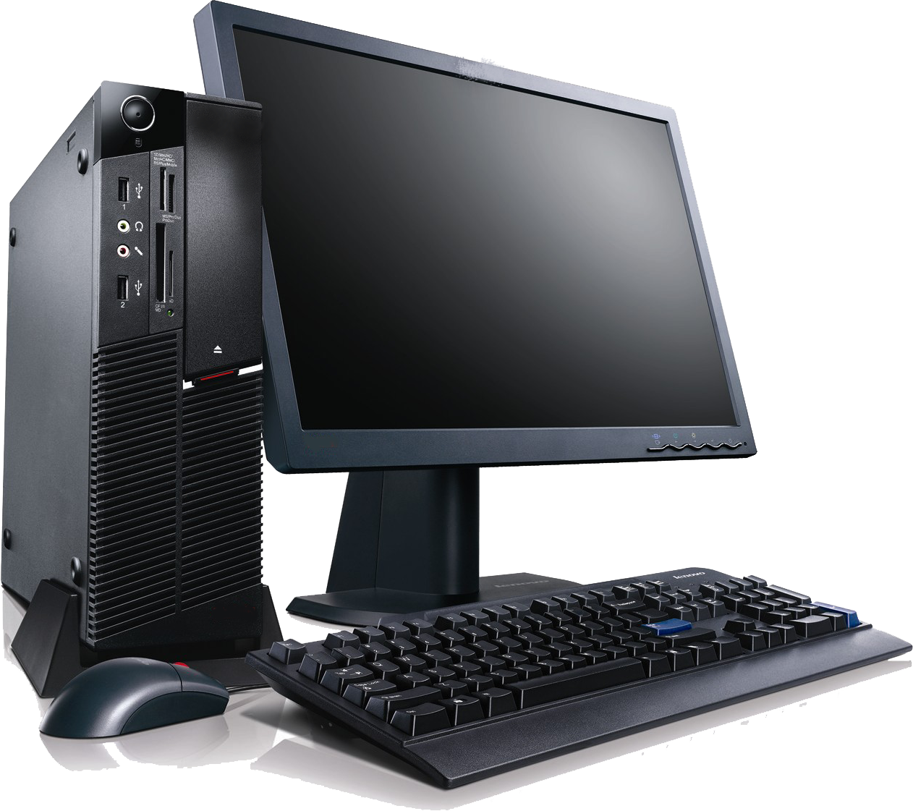

192.168.0.1
192.168.0.2
Kirim file .rar melalui FTP
Application
Application
Presentation
Presentation
Session
Session
Transport
Transport
Network
Network
Data Link
Data Link
Physical
Physical

Slide 5
192.168.0.1
192.168.0.2
Application
FTP
Application
Presentation
Presentation
Session
Session
Transport
Transport
Network
Network
Data Link
Data Link
Physical
Physical

Slide 6
192.168.0.1
192.168.0.2
Application
FTP
Application
Presentation
.rar
Presentation
Session
Session
Transport
Transport
Network
Network
Data Link
Data Link
Physical
Physical

Slide 7
192.168.0.1
192.168.0.2
Application
FTP
Application
Presentation
.rar
Presentation
Session
Session
Transport
Transport
Network
Network
Data Link
Data Link
Physical
Physical

Slide 8
192.168.0.1
192.168.0.2
Application
FTP
Application
Presentation
.rar
Presentation
Session
Session
Transport
Transport
Network
Network
Data Link
Data Link
Physical
Physical

Slide 9
192.168.0.1
192.168.0.2
Application
FTP
Application
Presentation
.rar
Presentation
Session
Session
Transport
TCP
Transport
Network
Network
Data Link
Data Link
Physical
Physical

Slide 10
192.168.0.1
192.168.0.2
Application
FTP
Application
Presentation
.rar
Presentation
Session
Session
Transport
TCP
Transport
Network
192.168.0.2
Network
Data Link
Data Link
Physical
Physical

Slide 11
192.168.0.1
192.168.0.2
Application
FTP
Application
Presentation
.rar
Presentation
Session
Session
Transport
TCP
Transport
Network
192.168.0.2
Network
Data Link
MAC Address
Data Link
Physical
Physical

Slide 12
192.168.0.1
192.168.0.2
Application
FTP
Application
Presentation
.rar
Presentation
Session
Session
Transport
TCP
Transport
Network
192.168.0.2
Network
Data Link
MAC Address
Data Link
Physical
Fastethernet (UTP)
Physical

Slide 13
192.168.0.1
192.168.0.2
Application
Application
Presentation
Presentation
Session
Session
Transport
Transport
Network
Network
Data Link
Data Link
Physical
Fastethernet (UTP)
Physical

Slide 14
192.168.0.1
192.168.0.2
Application
Application
Presentation
Presentation
Session
Session
Transport
Transport
Network
Network
Data Link
MAC Address
Data Link
Physical
Fastethernet (UTP)
Physical

Slide 15
192.168.0.1
192.168.0.2
Application
Application
Presentation
Presentation
Session
Session
Transport
Transport
Network
192.168.0.1
Network
Data Link
MAC Address
Data Link
Physical
Fastethernet (UTP)
Physical

Slide 16
192.168.0.1
192.168.0.2
Application
Application
Presentation
Presentation
Session
Session
Transport
TCP
Transport
Network
192.168.0.1
Network
Data Link
MAC Address
Data Link
Physical
Fastethernet (UTP)
Physical

Slide 17
192.168.0.1
192.168.0.2
Application
Application
Presentation
Presentation
Session
Session
Transport
TCP
Transport
Network
192.168.0.1
Network
Data Link
MAC Address
Data Link
Physical
Fastethernet (UTP)
Physical

Slide 18
192.168.0.1
192.168.0.2
Application
Application
Presentation
.rar
Presentation
Session
Session
Transport
TCP
Transport
Network
192.168.0.1
Network
Data Link
MAC Address
Data Link
Physical
Fastethernet (UTP)
Physical

Slide 19
192.168.0.1
192.168.0.2
Application
FTP
Application
Presentation
.rar
Presentation
Session
Session
Transport
TCP
Transport
Network
192.168.0.1
Network
Data Link
MAC Address
Data Link
Physical
Fastethernet (UTP)
Physical

Slide 20
Sumber
Tujuan
Application
Application
Presentation
Presentation
Session
Session
Transport
Transport
Network
Network
Data Link
Data Link
Physical
Physical

Slide 21
OSI Layer
Pada Switch

Slide 22
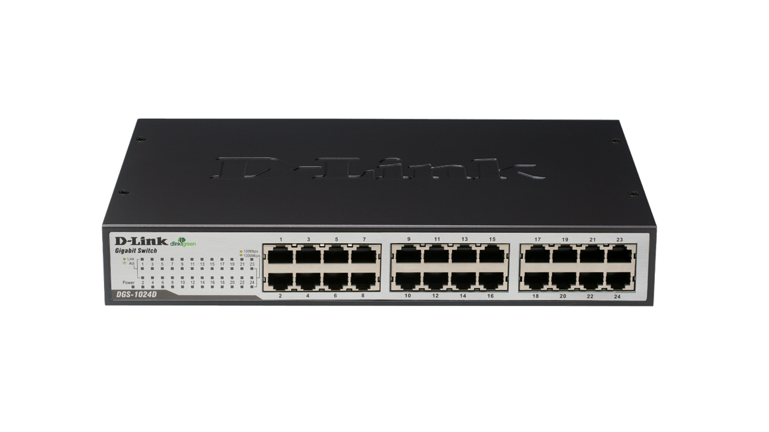
Sumber
Tujuan
Application
Application
Presentation
Presentation
Session
Session
Transport
Transport
Network
Network
Data Link
Data Link
Data Link
Physical
Physical
Physical

Slide 23
OSI Layer
Pada Router & Multilayer Switch (Switch Layer 3)

Slide 24
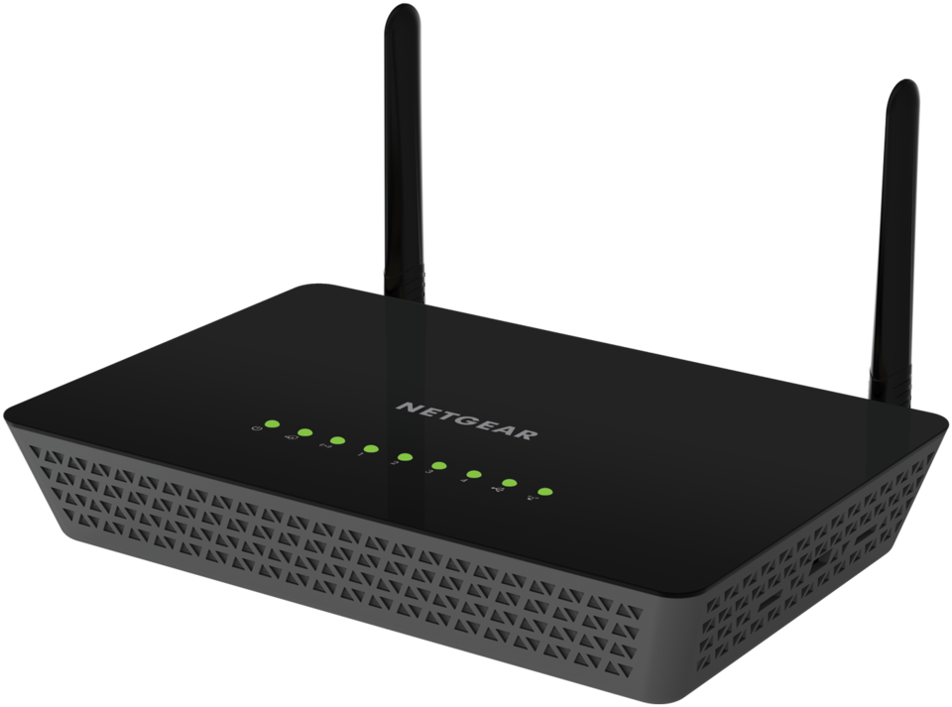
Sumber
Tujuan
Application
Application
Presentation
Presentation
Session
Session
Transport
Transport
Network
Network
Network
Data Link
Data Link
Data Link
Physical
Physical
Physical

